Slide 1

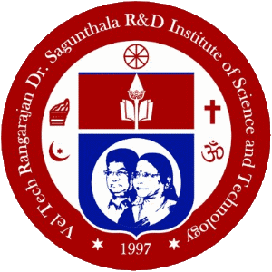
Vel Tech Rangarajan Dr. Sagunthala R&D Institute of Science and Technology
Photo Booth
Department of Computer Science and Engineering
MAYURAKSHYA PAUL
ROHIT KUMAR

Slide 2
PROBLEM STATEMENT
In old times there was lack of good camera to capture, the pictures captured were usually black and white or distorted. The restoration of these photos are usually very difficult and its costly too. There is need to implement this concept in a fast and cheap way.

Slide 3
ABSTRACT
Photos are not just captured images but its also a captured emotion of a faded memory. In old times, when the photo industry was not so developed, the cameras captured pictures in black and white. Also there was no option of saving it digitally. Presently we have advanced technologies to generate a hd quality pic and save it digitally so as to generate it whenever required. But when it comes to restoring the old pics, it becomes quiet difficult. Also the cost of restoration is very high and time taking. The photo editing tools like photoshop has made it possible but it can’t provide a realistic colour pic. The demonstrated solution is a machine learning based model which can predict the perfect blend of colours to restore a black and white image to turn into colourful image magically. It can be used to generate high quality images in seconds.

Slide 4





Costly
Not Accurate
Existing
Solution
Difficult to identify different color gradient
Time Taking
Difficult to convert videos

Slide 5





GAN modified algorithm
01
02
Edge detection
TECHNOLOGY STACK
03
Hugging Face Library
04
Binary Classifier

Slide 6
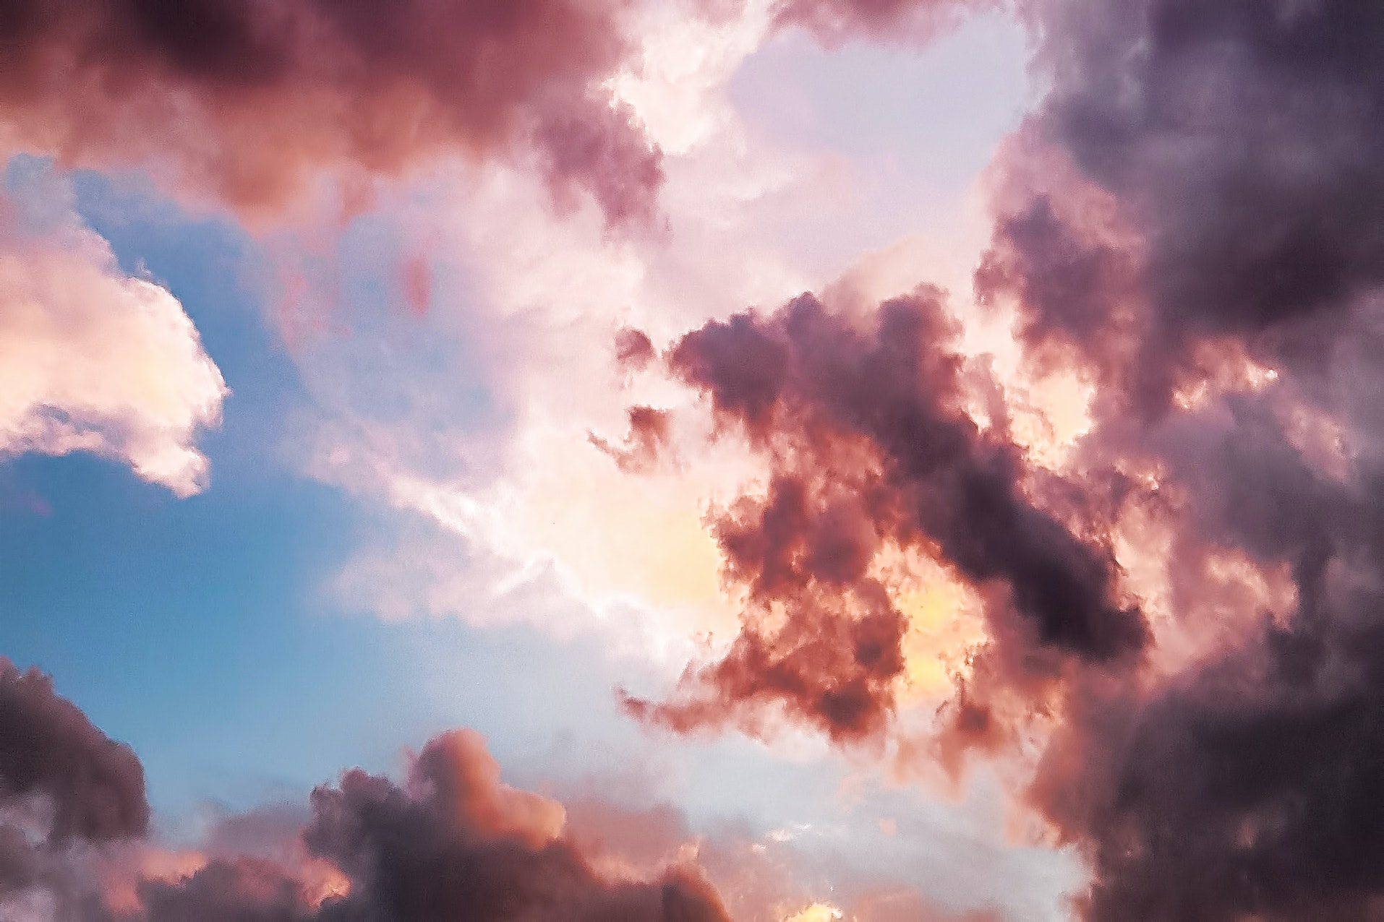




RESULTS

Slide 7
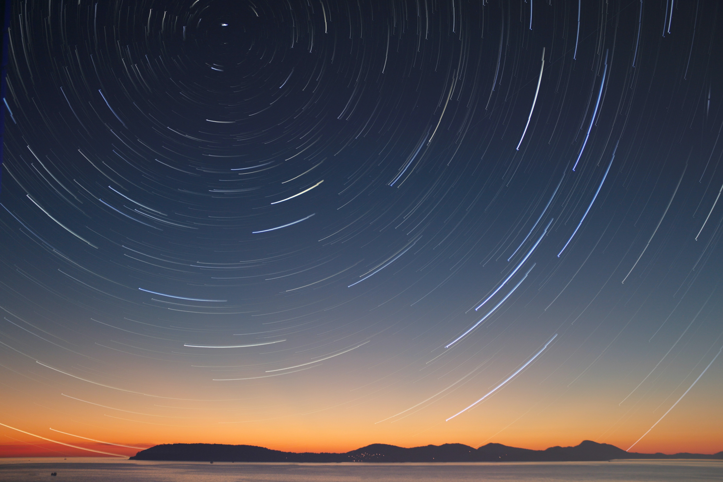
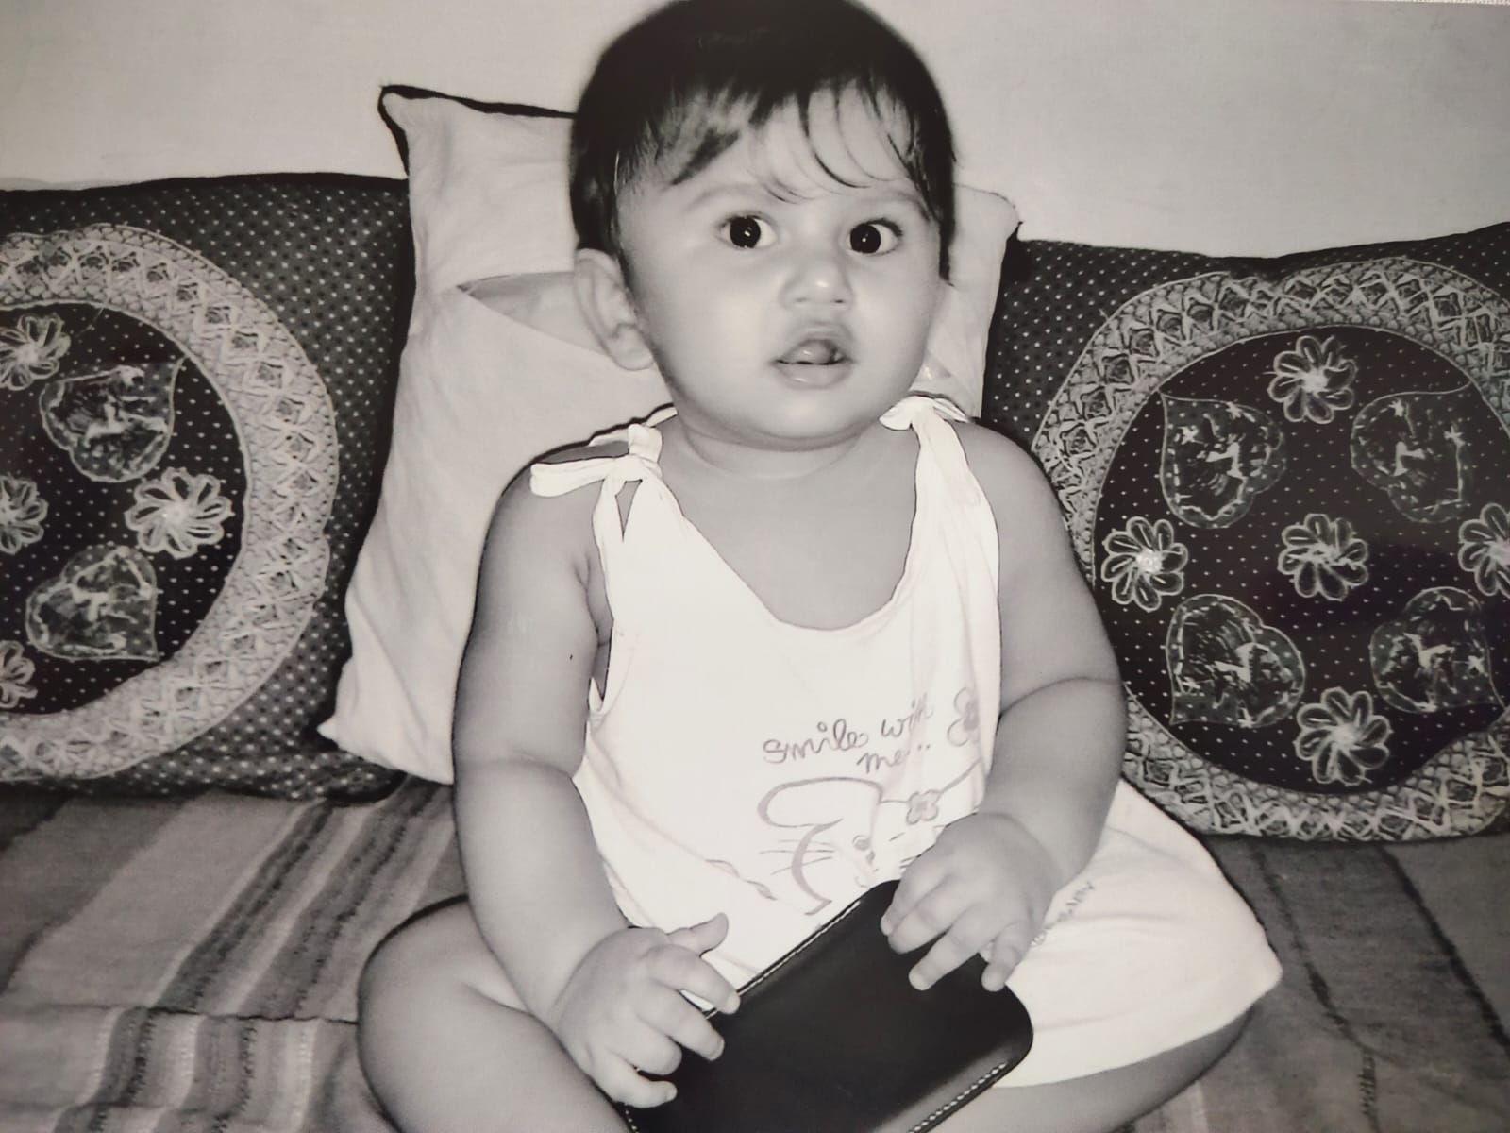
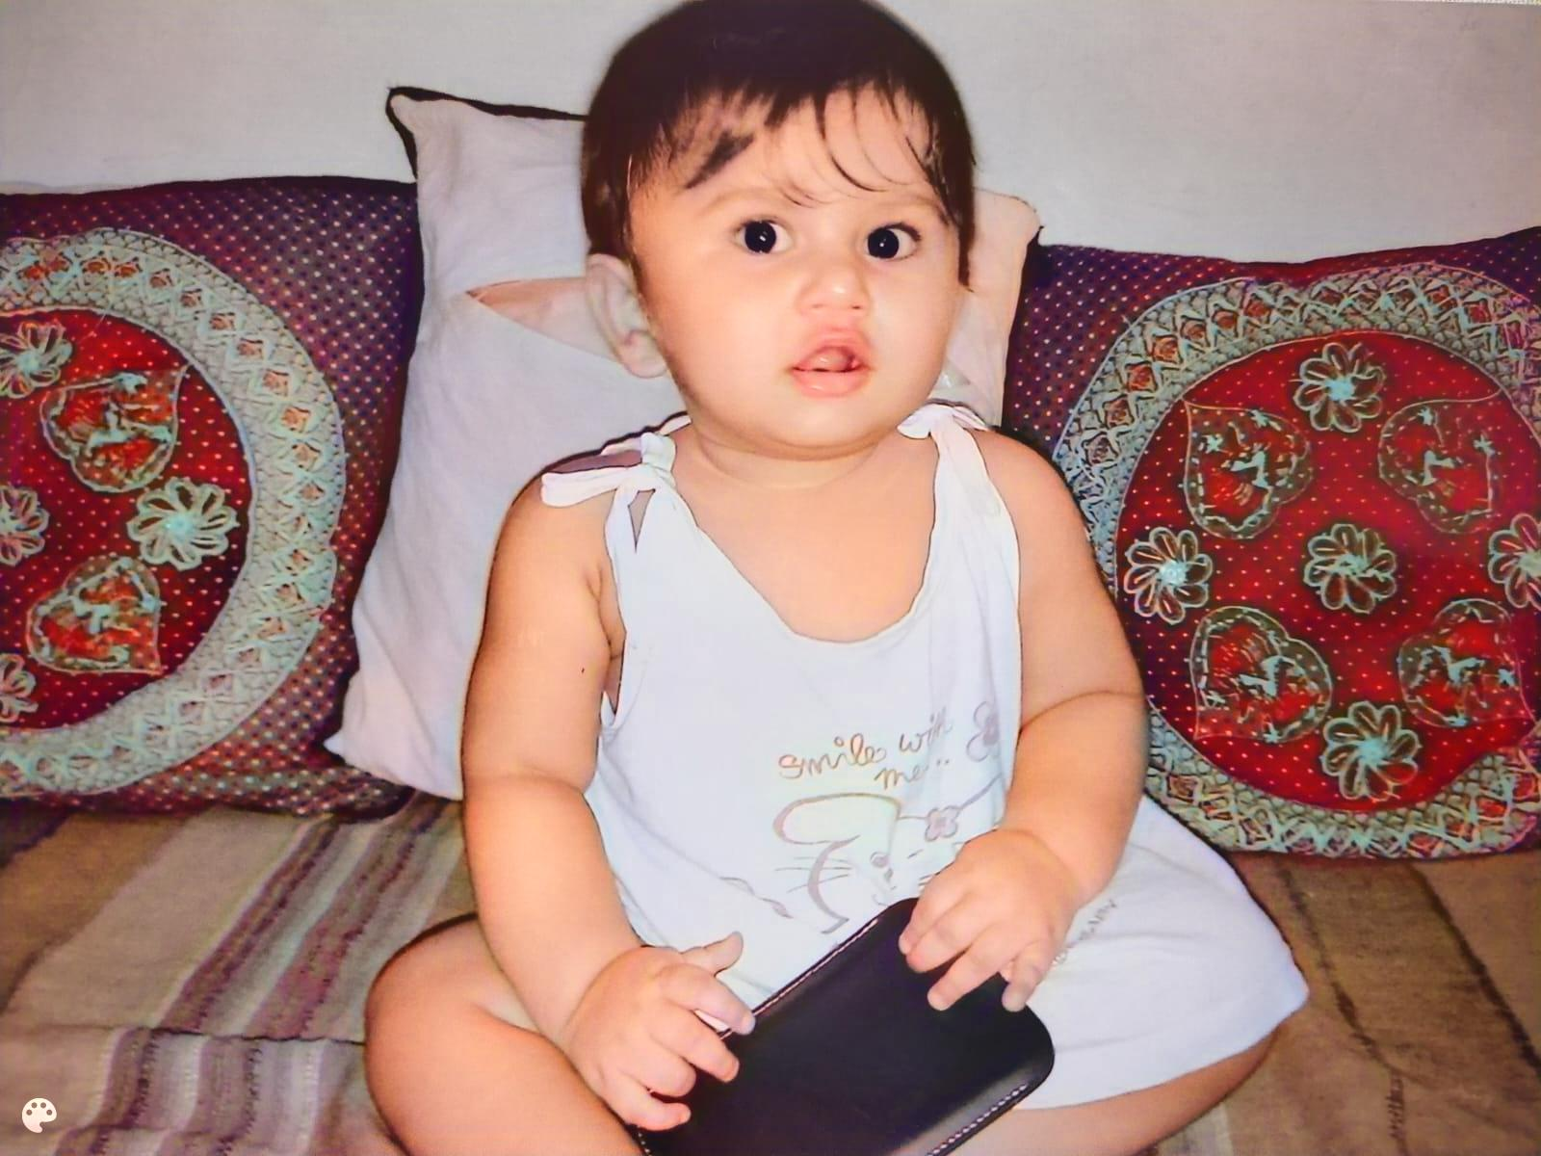

Slide 8
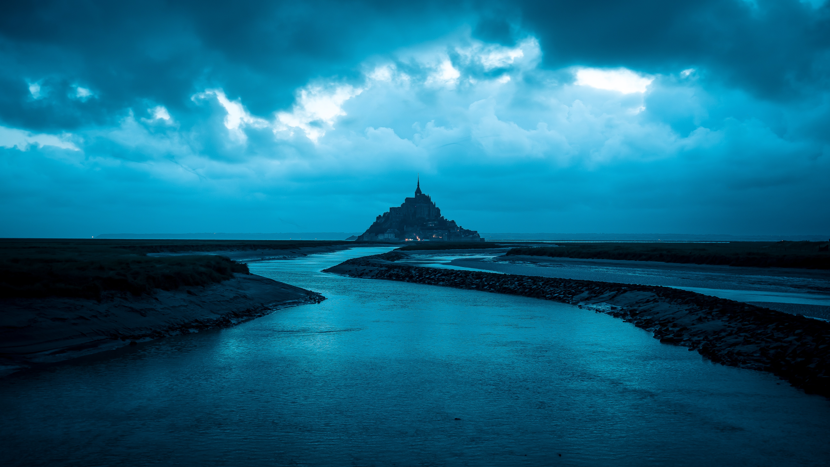
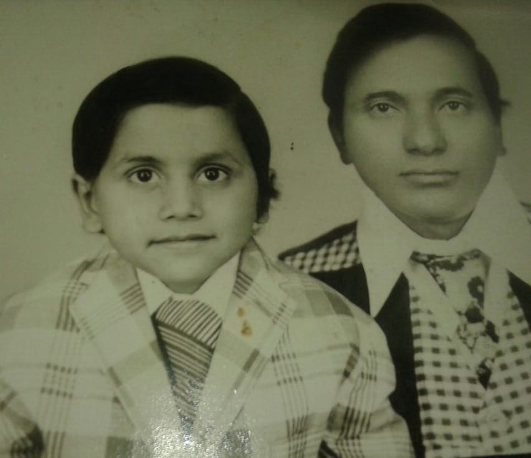
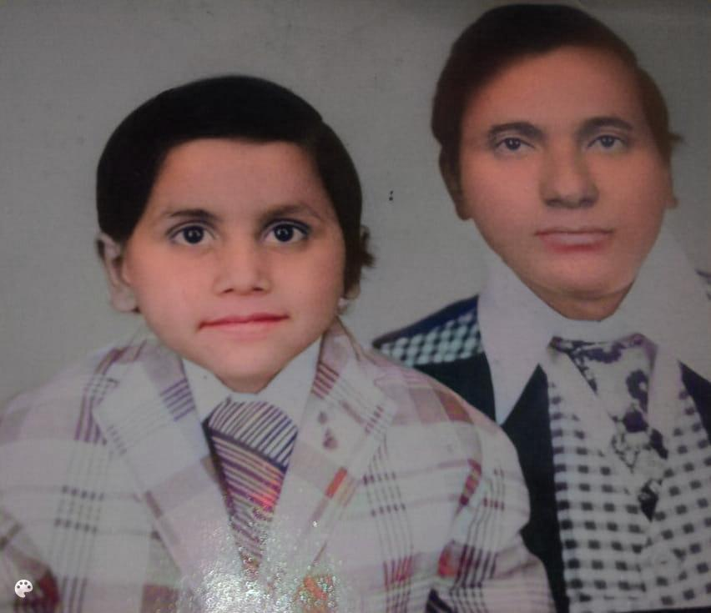

Slide 9

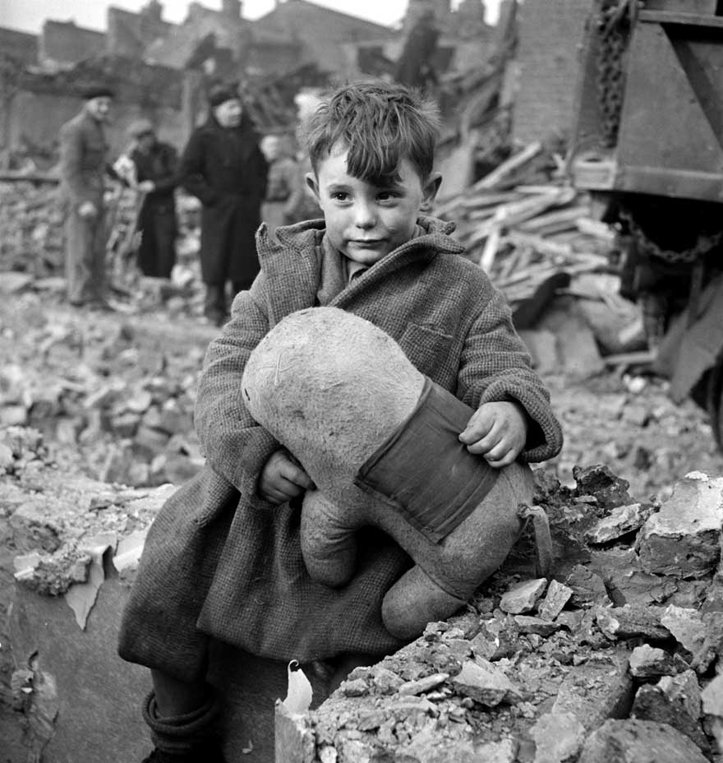
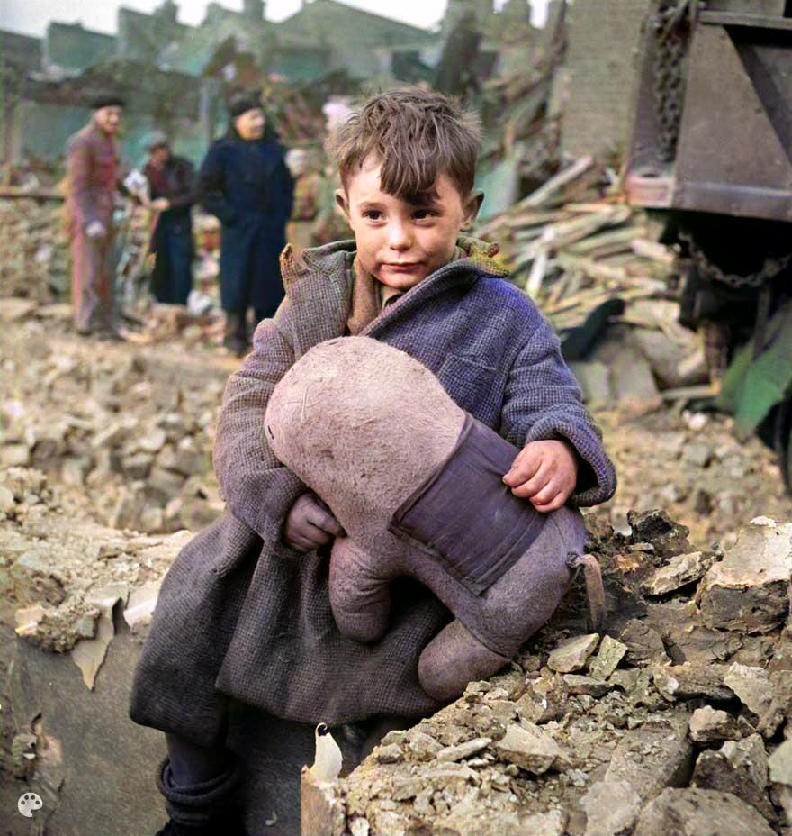

Slide 10
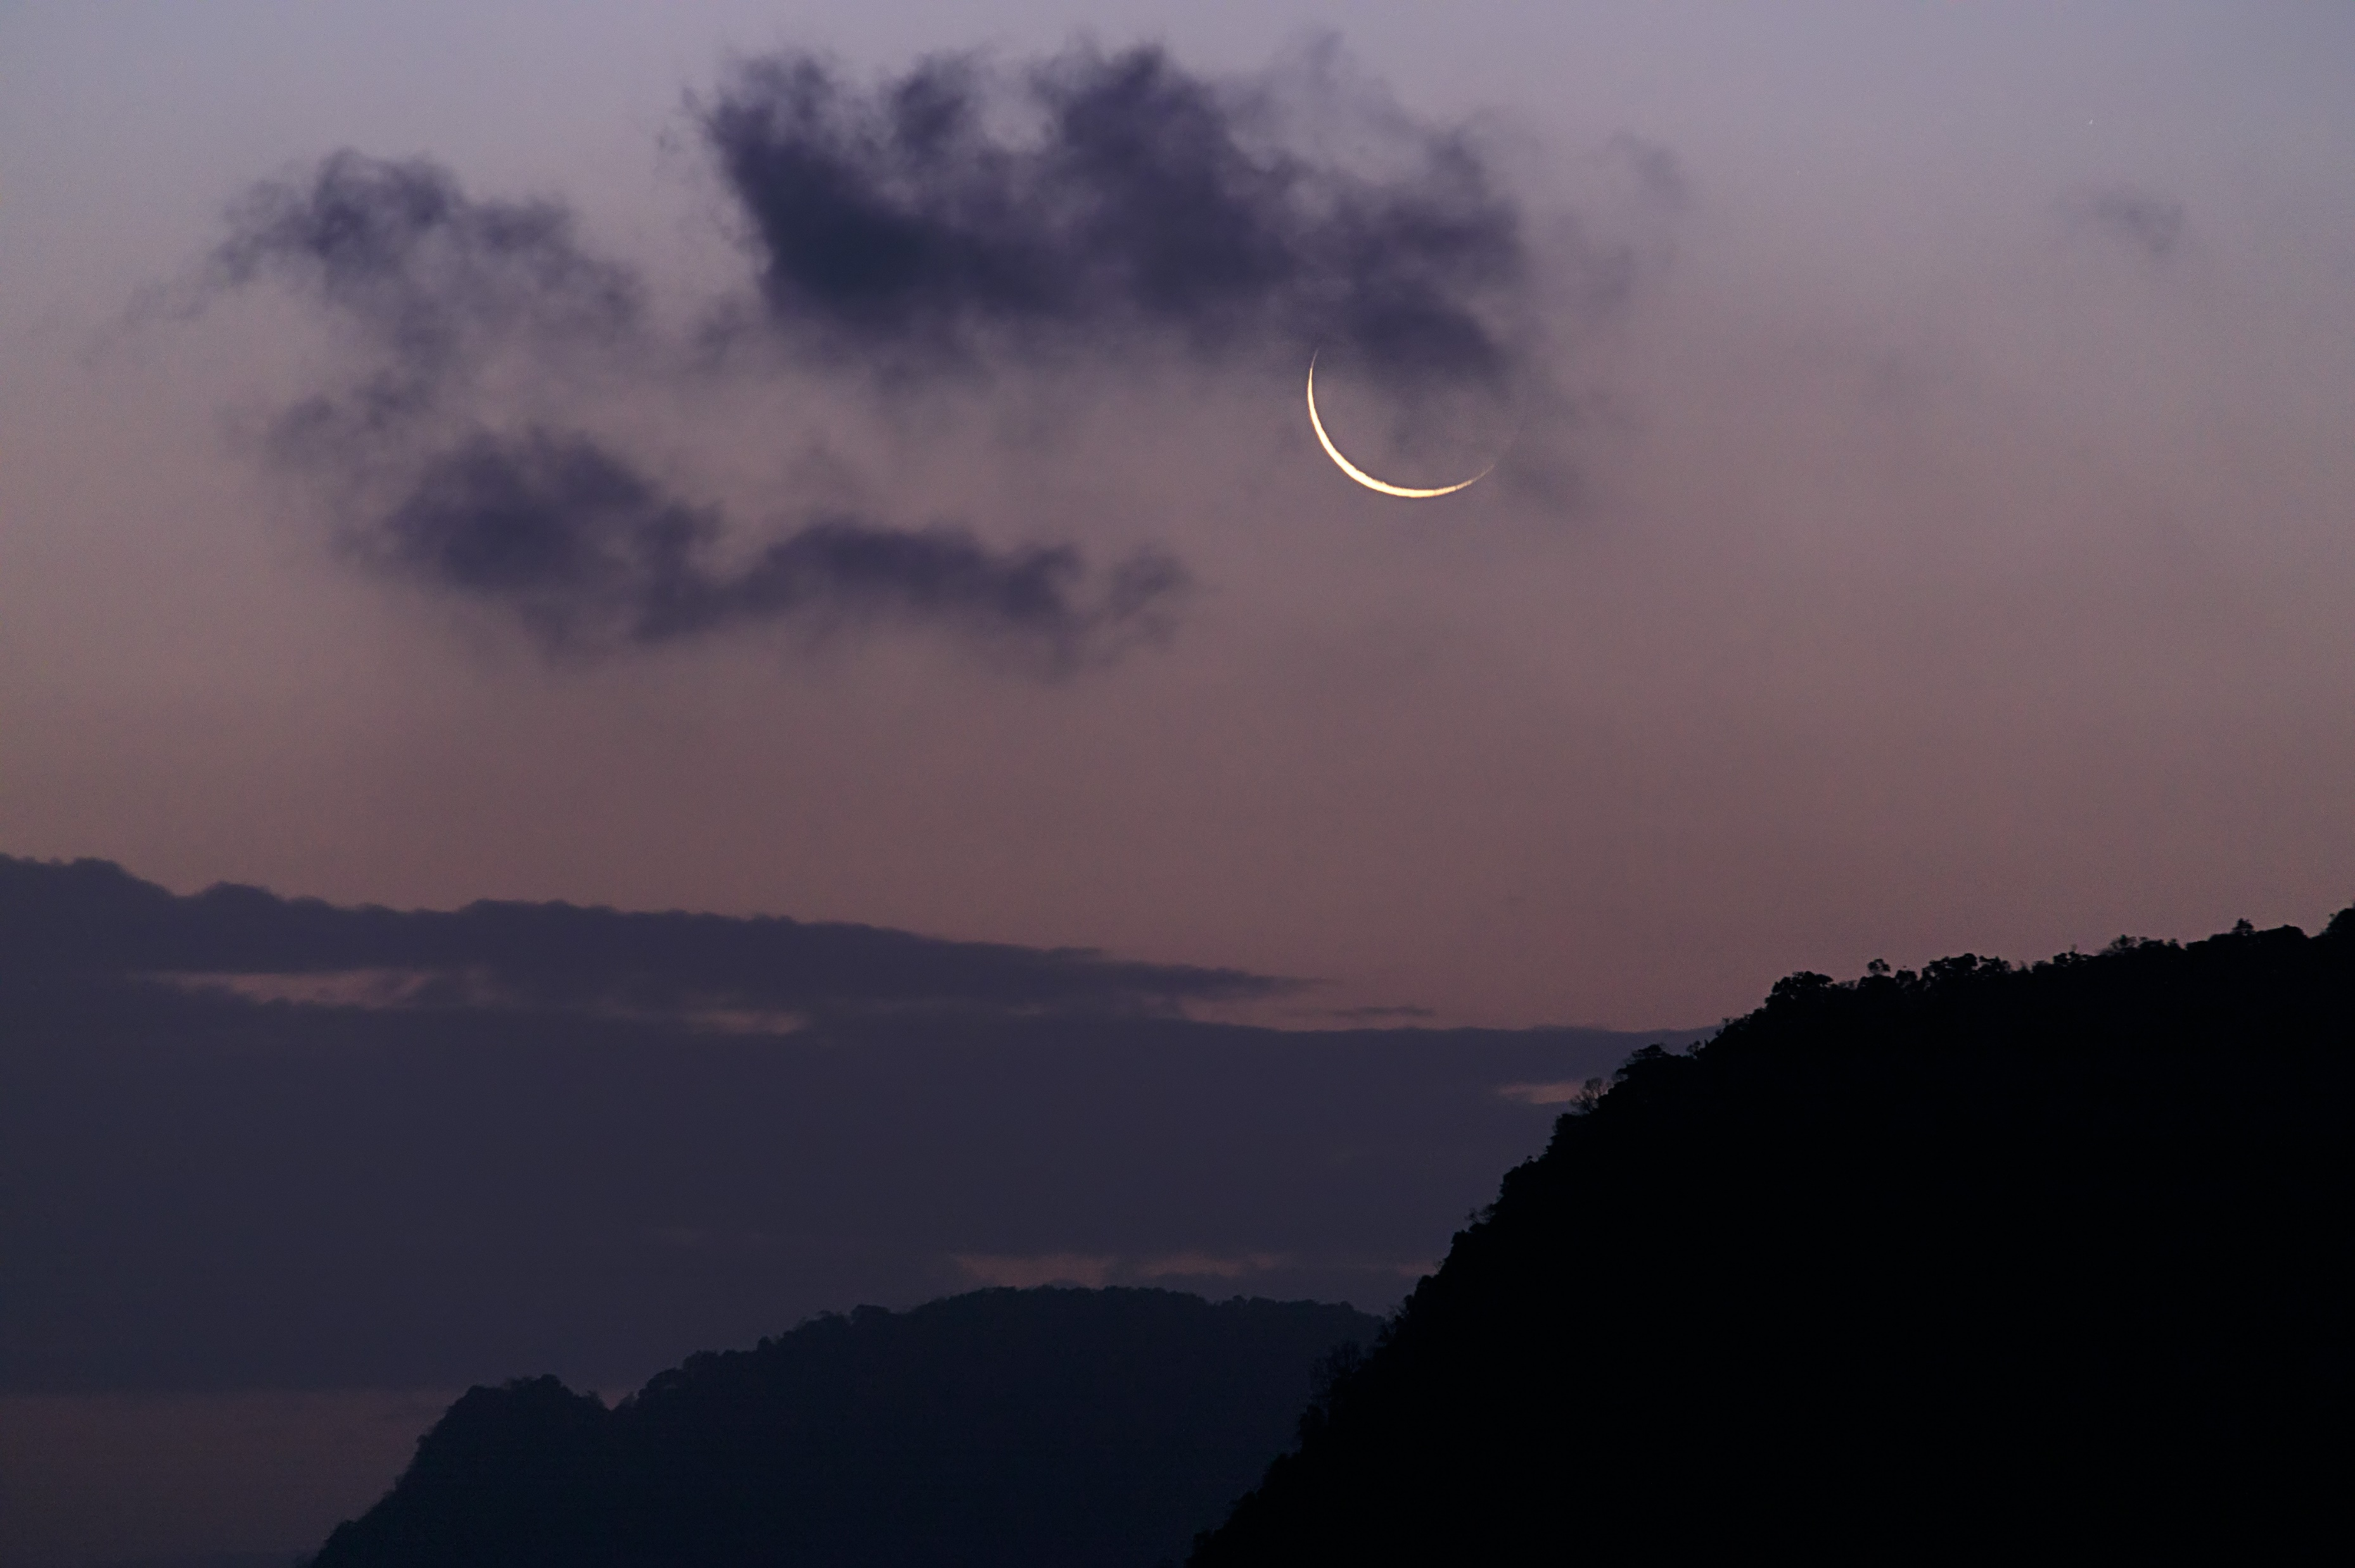
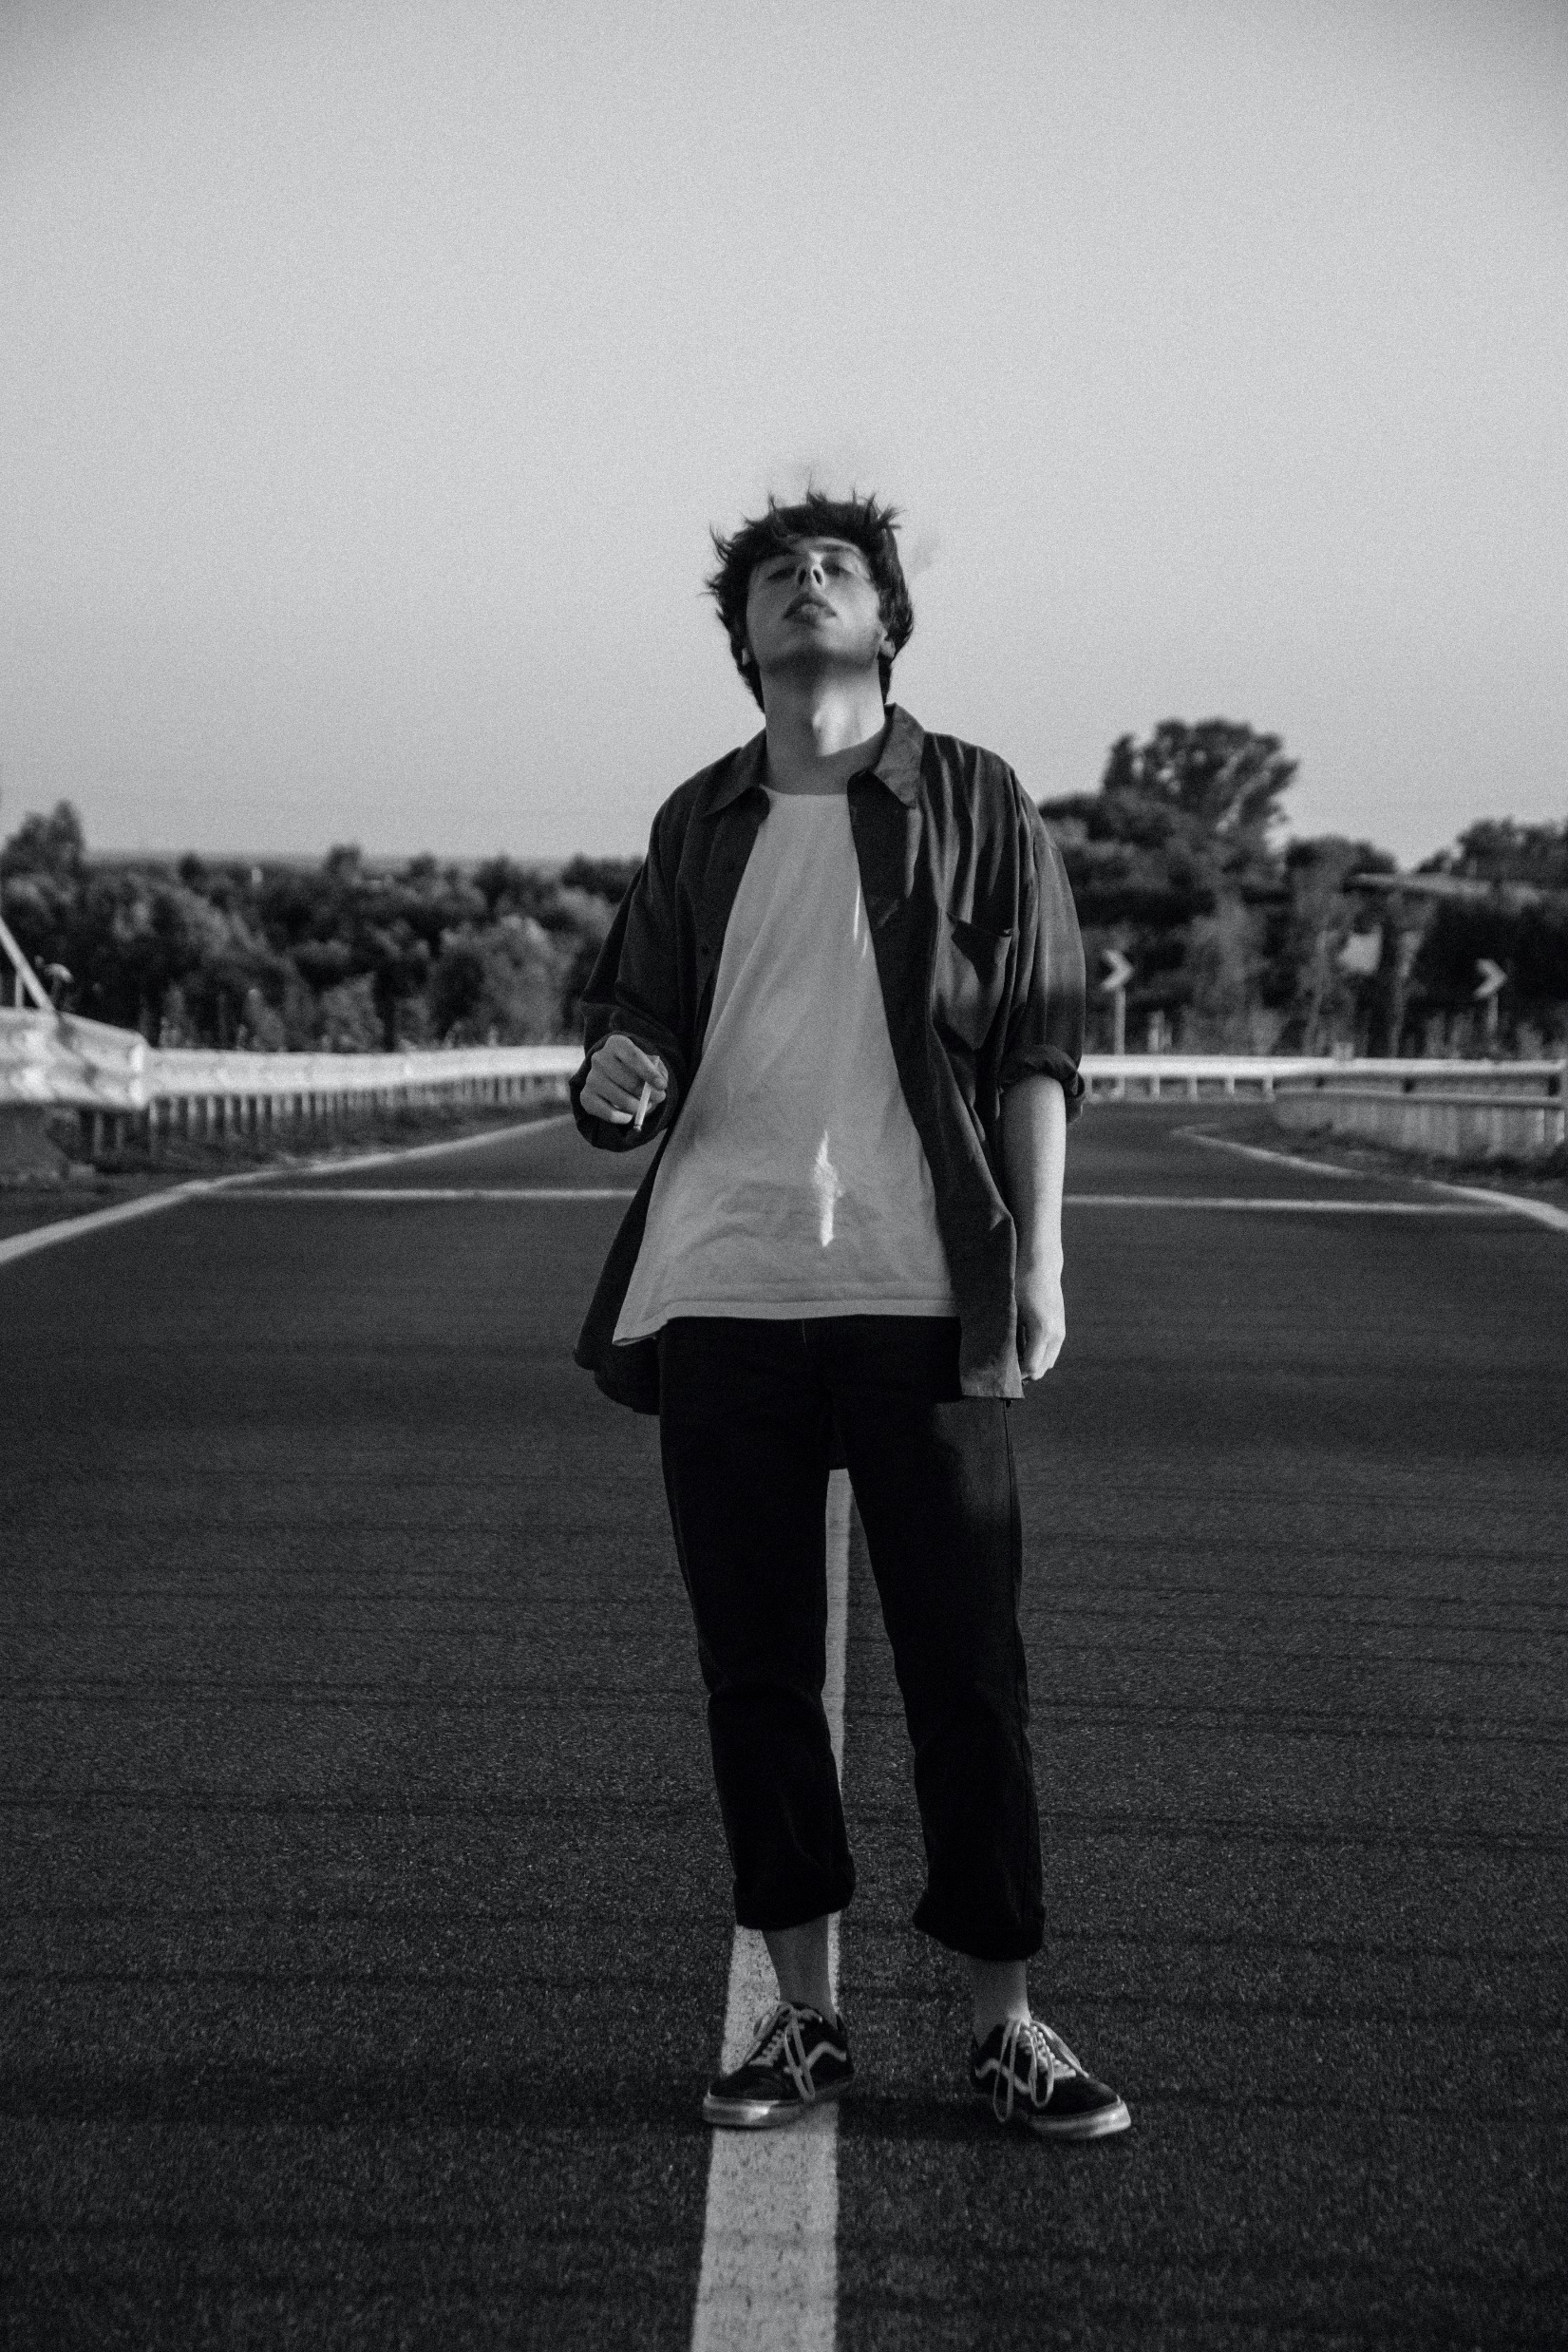
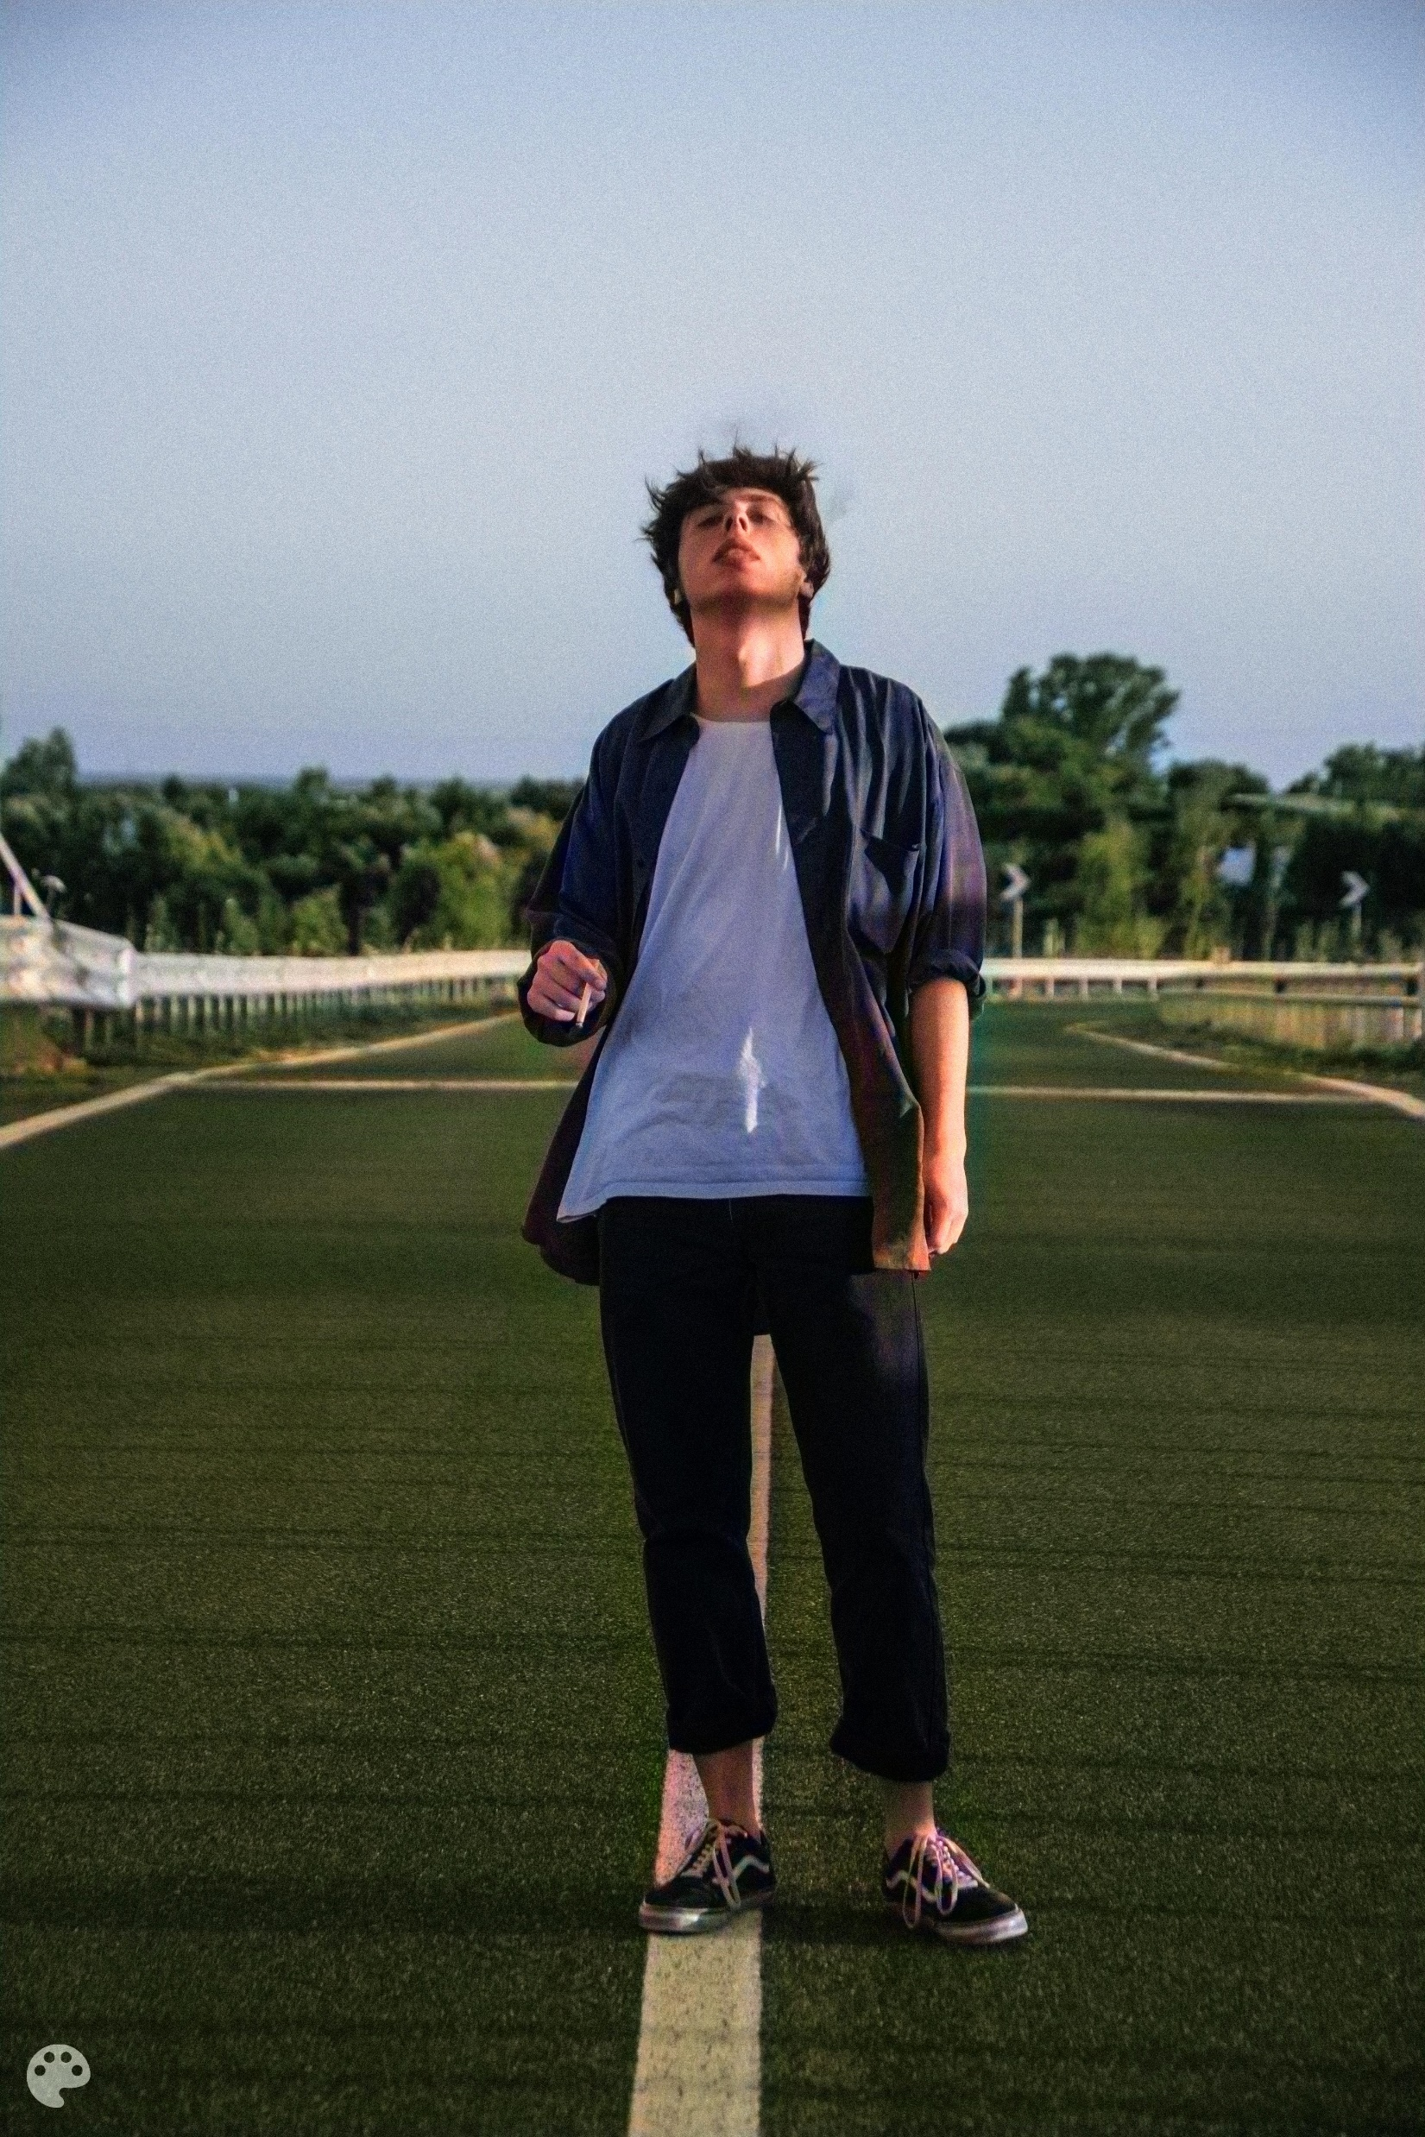

Slide 11

THANK YOU
For any queries kindly procced

